Slide 1

SolidWorks Design Project: The Bicycle
Jason Younan

Slide 2
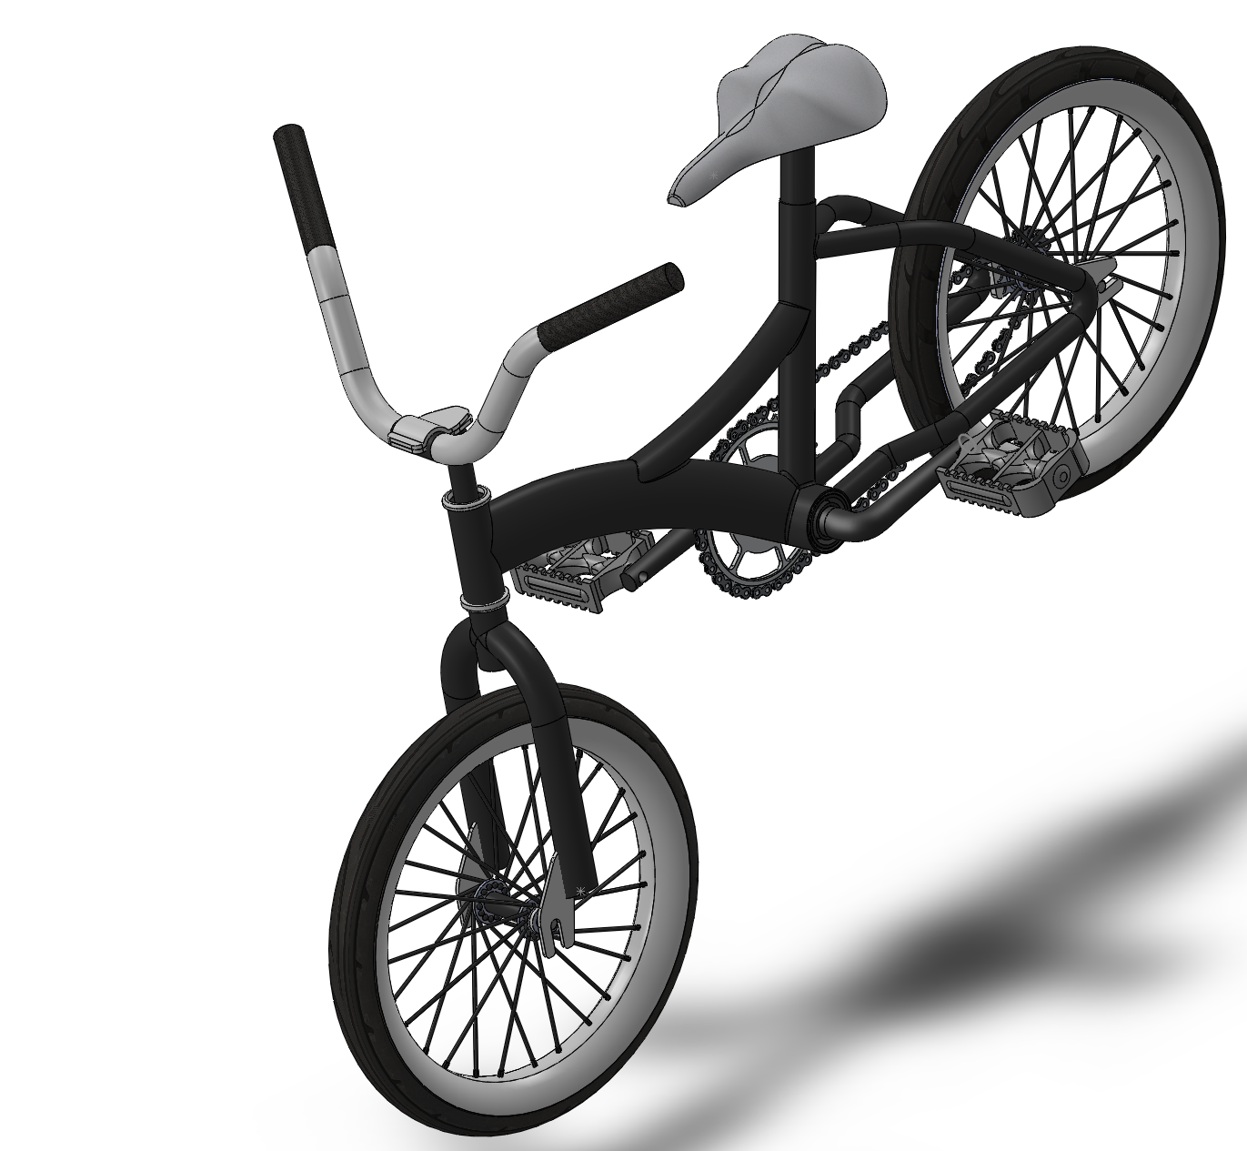
The Bicycle
Bicycle (noun):
A vehicle with two wheels tandem, handlebars for steering, a saddle seat, and pedals by which it is propelled
As a kid I always loved riding the bicycle and I spent a lot of my childhood just riding around the neighborhood with my friends. This was our way to get around without having to ask our parents to drive us from house to house, so I thought it would cool to build a big part of my childhood.

Slide 3
Project Schedule

Slide 4
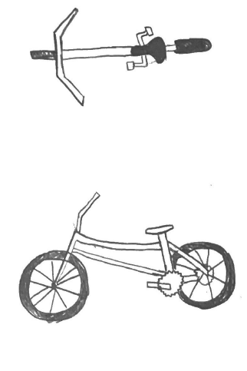
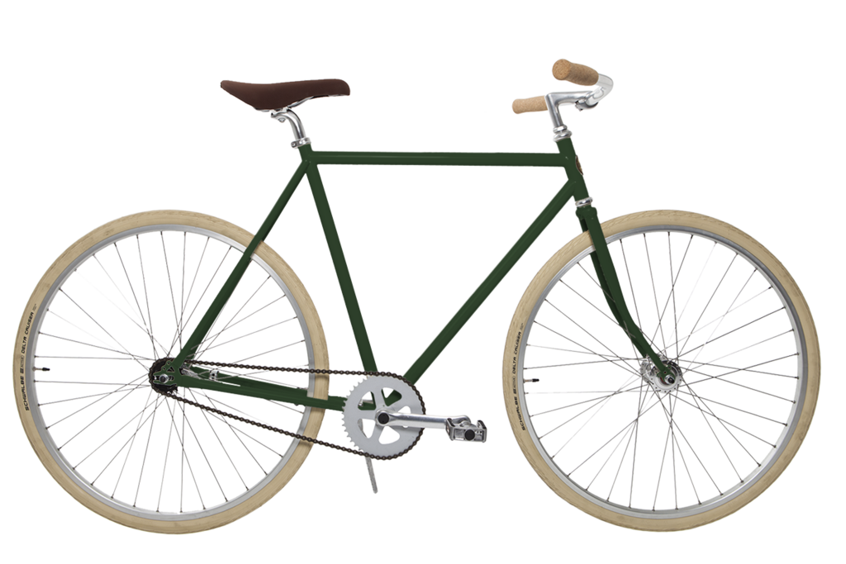
Brainstorming Process

Slide 5
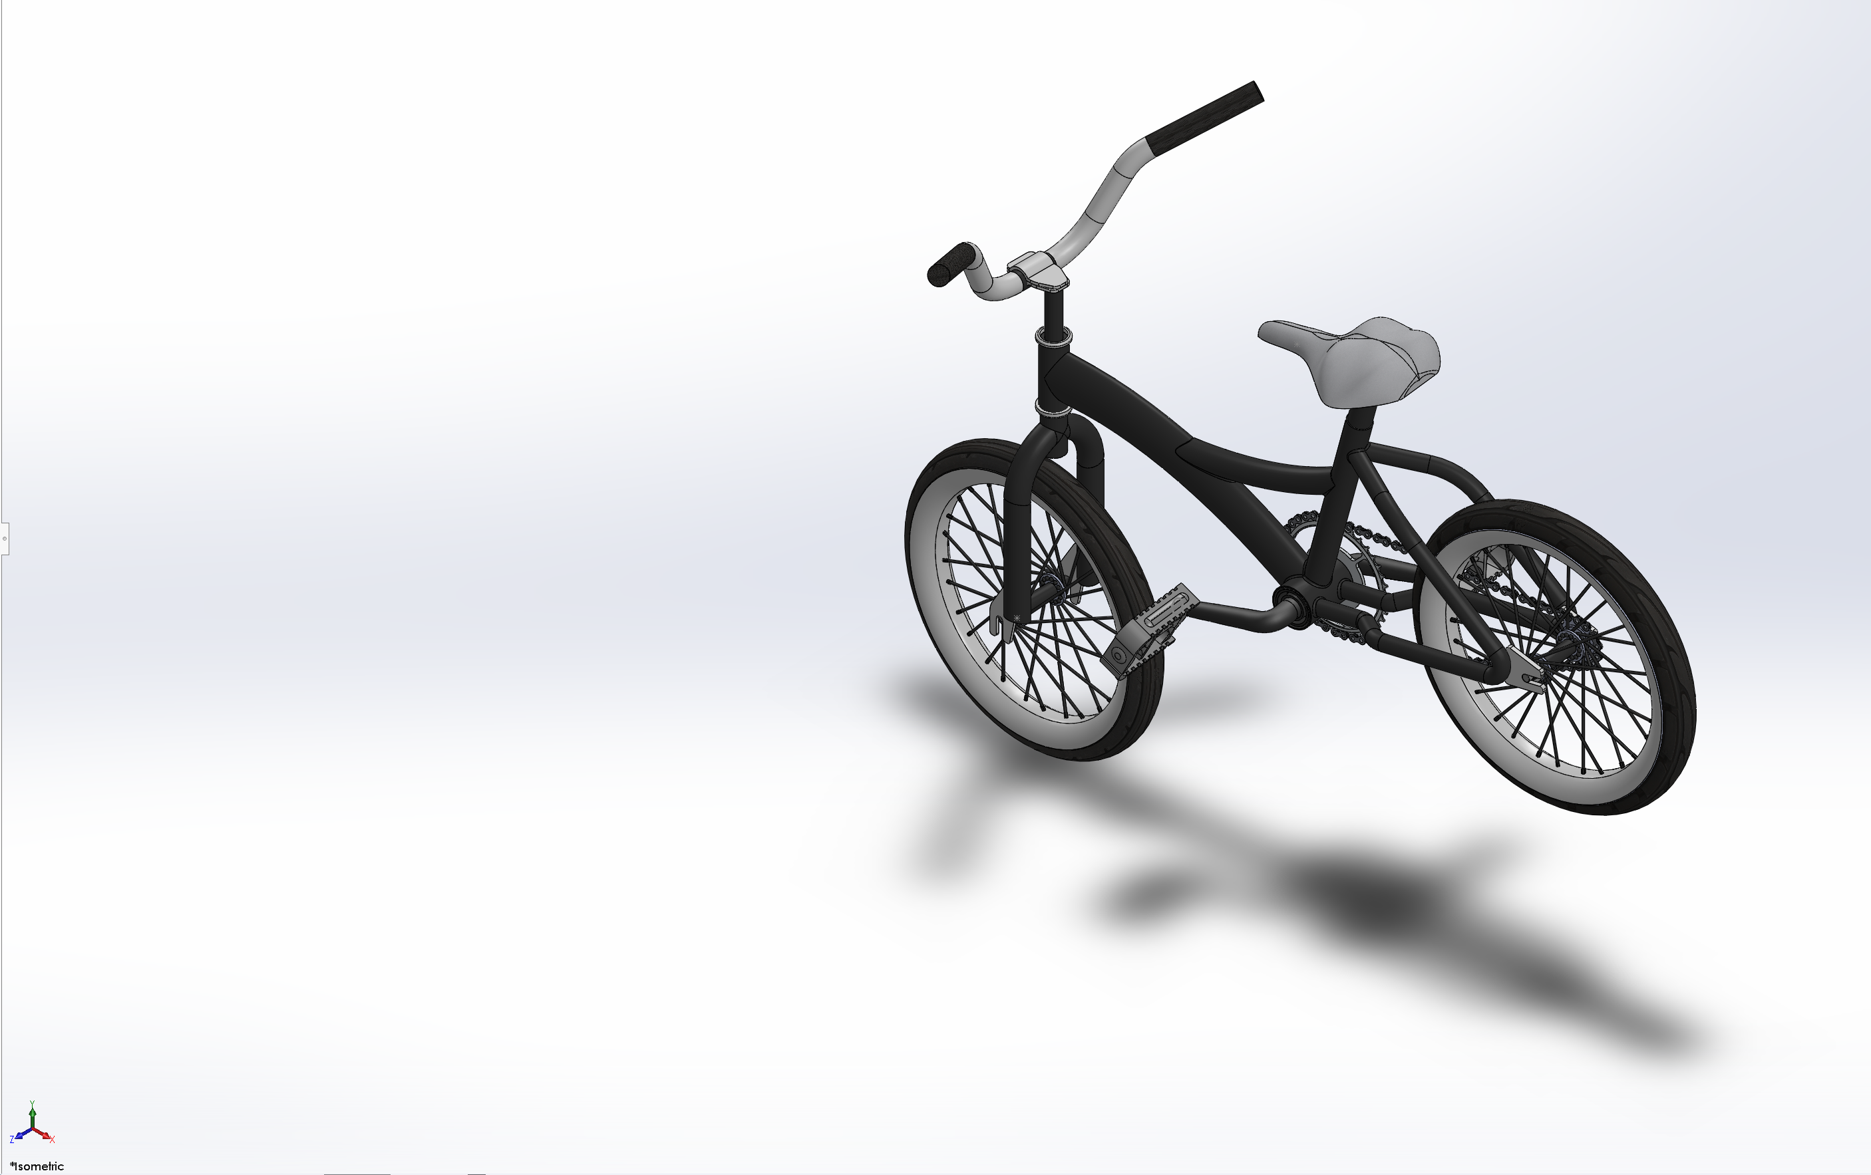
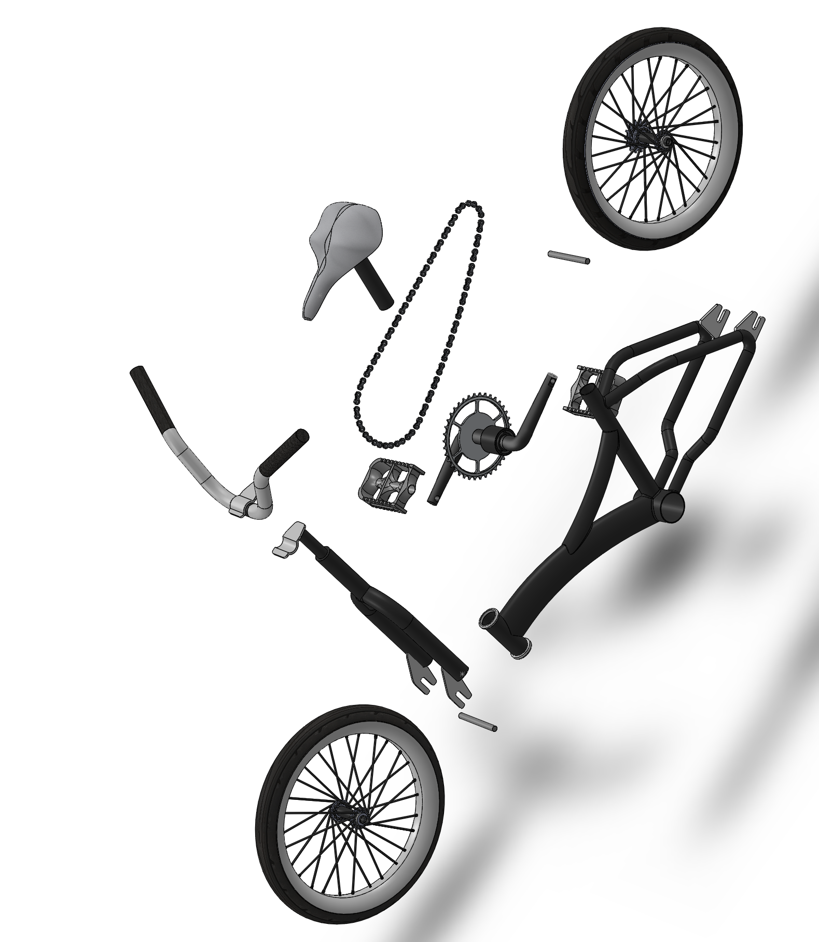
Exploded View
Isometric View

Slide 6
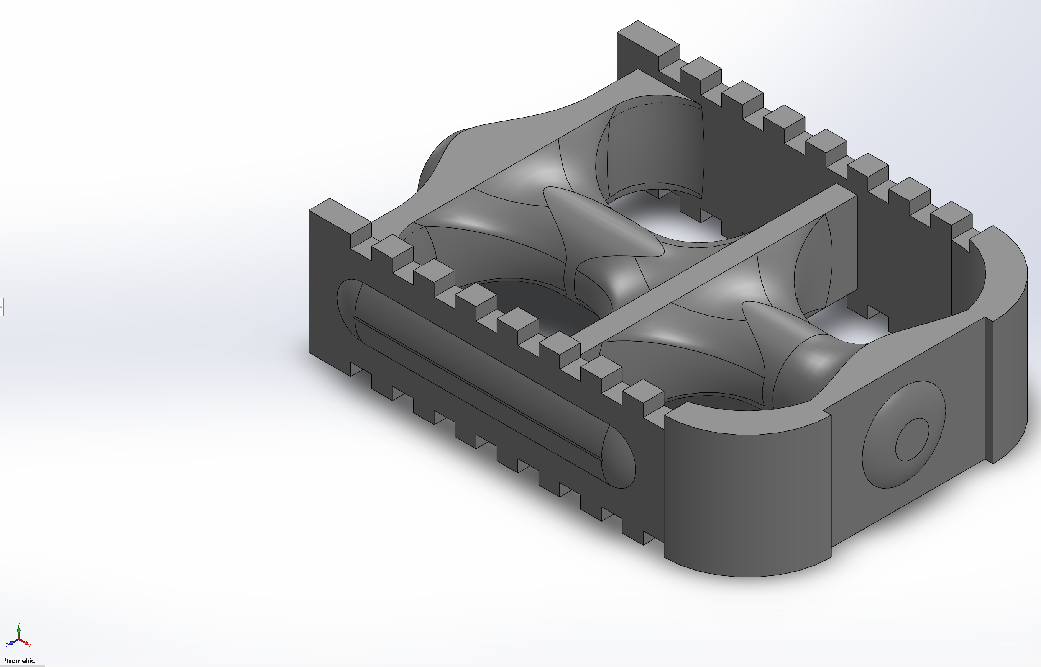
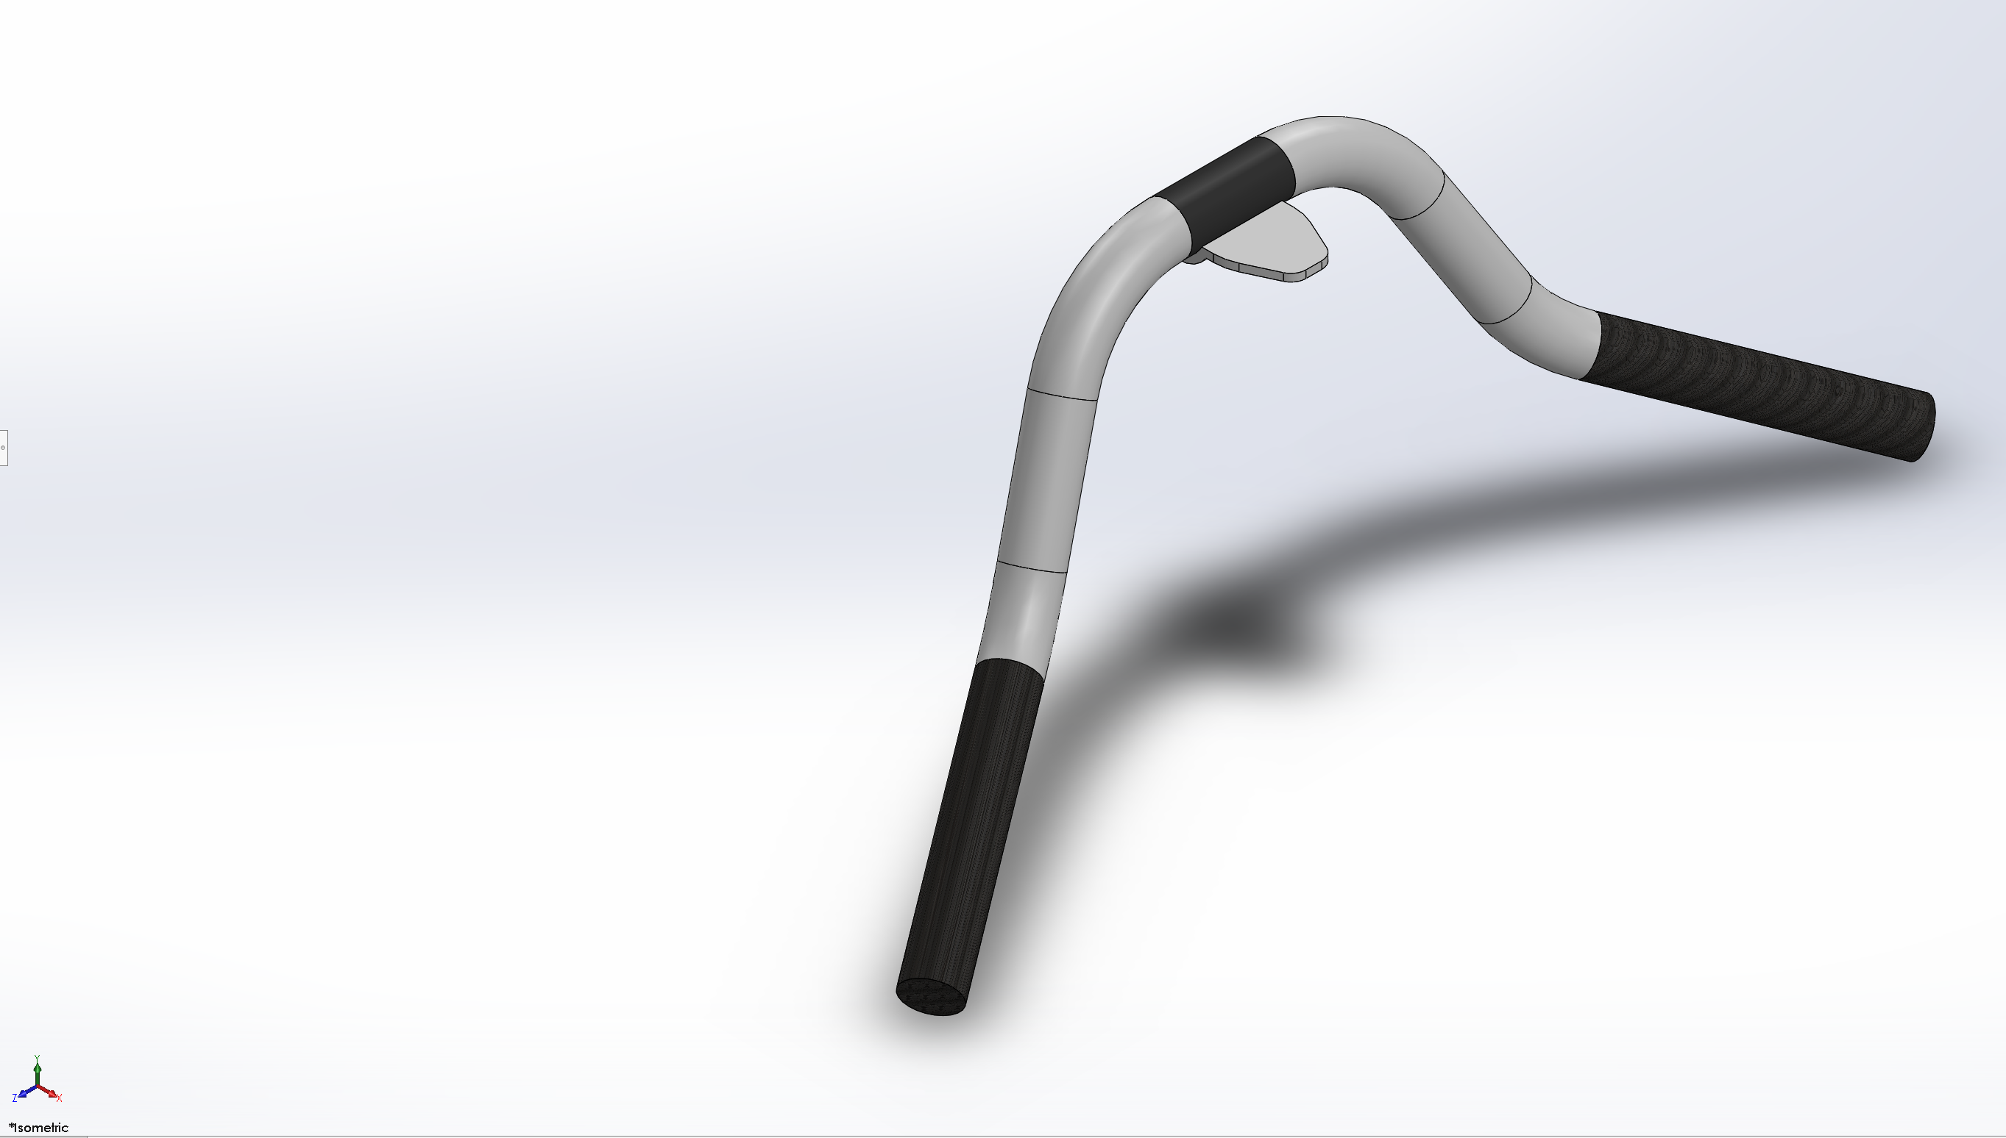
Difficulties

Slide 7
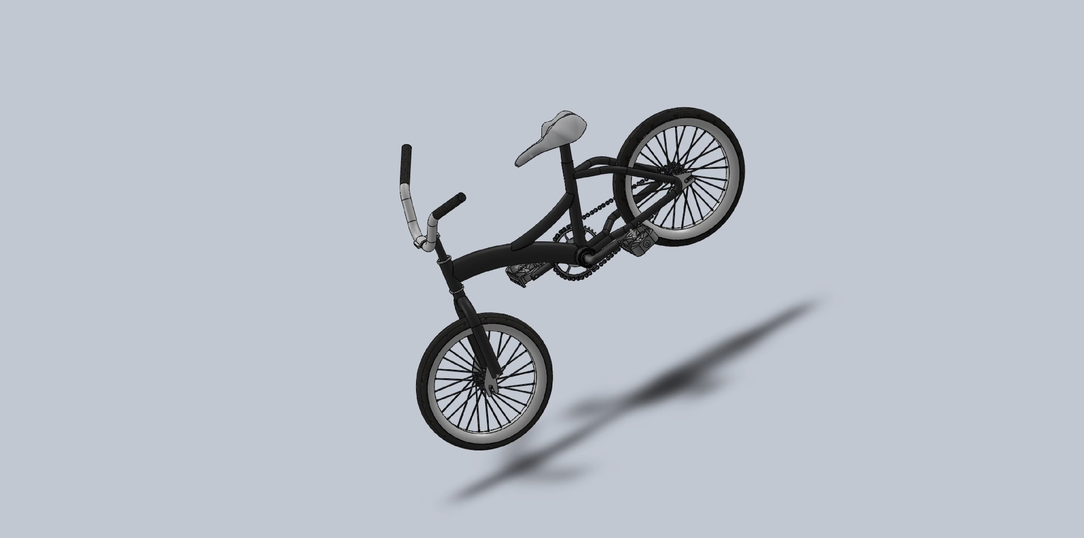

Slide 8
Any Questions?

